Slide 1
Unit 2 – Economic Indicators

Slide 2
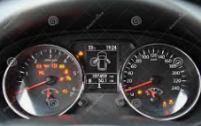
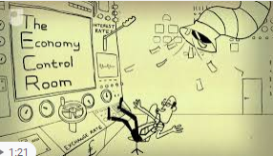
Economic Indicators
What is an indicator? It is a number/figure/piece of information that helps us to know the condition of something.
Eg. The panel on a car gives us a lot of information
An economic indicator is therefore a number/figure/piece of information that gives us information about the condition of the economy.
What are some important indicators for the economy?
Inside the ‘control room of the economy’ there are many dials and screens showing important indicators.

Slide 3
3 Crucial Economic Indicators
The three biggest economic indicators used in Macroeconomics are:
Gross Domestic Product (how big is the economy)
Unemployment (how many people have jobs)
Inflation (how stable are the prices of goods and services)
Economic Indicators
Gross Domestic Product (GDP)
Unemployment
Inflation
3 Economic Indicators

Slide 4


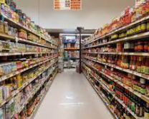
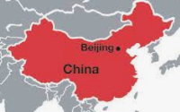
Gross Domestic Product (GDP)
One of the most important measurements is Gross Domestic Product (GDP).
We use GDP to measure the size of the economy.
Gross = all
Domestic = in the country, within the geographical borders
Product = goods and services
So GDP = all the goods and services in the country produced in one year!
In order to measure this, we have to use monetary units (US Dollars, Euros, RMB) to measure the value of the output.
Note: China’s GDP is counted as the value of goods/services produced within the borders of China.
GDP = Gross Domestic Product = The total monetary value of everything produced in the economy in one year.
Video and Interactive Quiz
http://www.econedlink.org/interactives/EconEdLink-interactive-tool-player.php?iid=204.

Slide 5
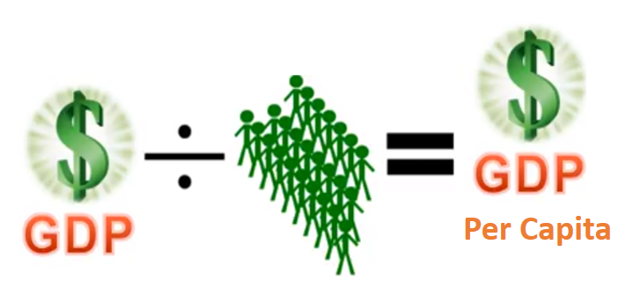
GDP per Capita
Note: A large economy such as India or China will have a very large GDP but will have a smaller GDP per capita than small wealthy countries such as Norway, Switzerland etc.
List of countries by GDP (in US dollars)
What is GDP per capital?
GDP/Output per person
Calculated by dividing GDP by total population
GDP per capita is a better indication of ‘standard of living’ than is absolute GDP. Because when output per person is high, then the average citizen will have higher income.
Summary
Per capita = per person
GDP per capita = how rich the average person is

Slide 6
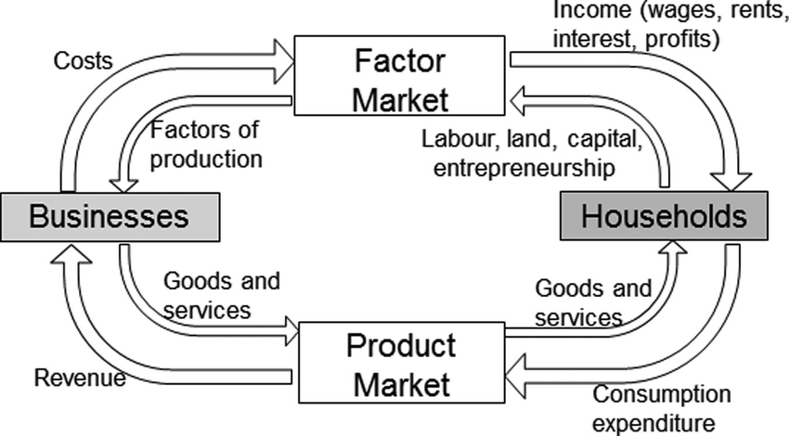
Circular Flow (Link)
The circular flow model shows a simplified version of all economic activity in a national economy.
There is a flow of goods and services and money between the different entities in the economy.
In the simplified circular flow model it is just households and businesses.
Once we have understood this basic model, we can add more entities to make the model more complex and realistic.
Businesses – buy: resources, sell: products
Households – buy: products, sell: resources

Slide 7
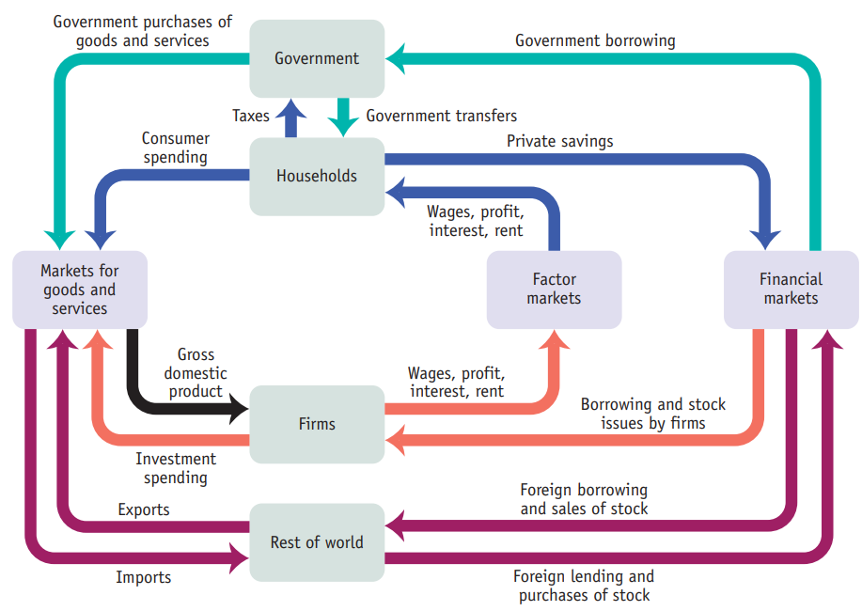
Draw a full circular flow model
Hint:
What are the 5 groups that move money?
Households, firms, gov, rest of world, financial institutions
What does each group do?
Households – buy, save
Firms – borrowing and investment
Government – tax, borrowing, government spending
Banks – lending, collecting savings
Rest of world – borrowing, lending, imports, exports

Slide 8

Injections and Leakages in Circular Flow
Injections put money into the circular flow.
Leakages take money out of the circular flow.
These are (in the long run) equal.
Leakages (take money out of the circular flow)
There are three types of leakage or withdrawal from the circular flow.
Savings
Imports of goods and services
Taxation
Injections
(put money into the circular flow)
There are three types of injection of extra spending into the circular flow model.
Investment in capital goods
Exports of goods and services
Government spending

Slide 9
3 Ways of Calculating GDP (Gross Domestic Product)
Total Expenditure Method
Value Added Method
Factor Incomes Method
3 Ways of Calculating GDP

Slide 10
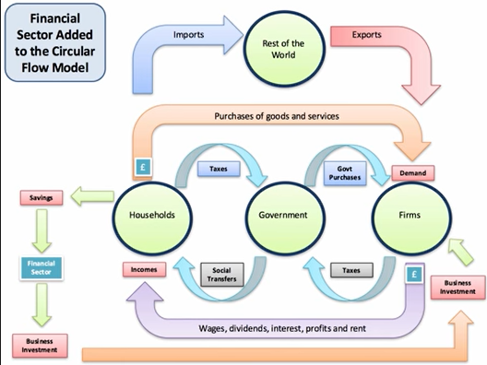
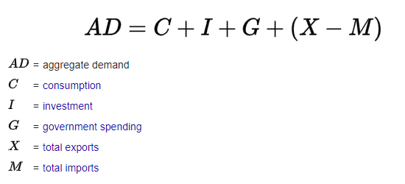
Total Expenditure
Expenditure is a way of measuring the total production in the economy. This makes sense because everything that is produced is satisfying the needs of the people in the economy.
So how much is spent in the economy in our circular flow?
Households
Firms
Government
Foreigners
Consumption, C
Investment, I
Y
GDP = C + I + G + (X-M)
Government Spending, G
Exports – Imports, (X-M)
Note: We don’t count businesses buying from households because that is essentially a trade between households and businesses (factors of production for goods) and so we only need to count one of them.
3 Ways of Calculating GDP

Slide 11
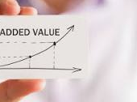


Value Added
We can also measure the size of the economy through the value added by businesses at different stages of production.
Eg. 1. A business turns a forrest into timber.
A transport company brings the timber to where it needs to go.
A manufacturing company turns the timber into furniture.
A retailer puts the furniture in a room with salespeople and helps customers make the right decision.
Each level creates output which has a higher value than the input they received! This is adding value!
Note: We subtract the cost of production also so the added value number will be smaller after this subtraction.
If we add each addition of value all through the economy this will be the value of production in the economy ie. GDP
The value we get will be the same as with the expenditure method.
Value = $20
Value = $150
3 Ways of Calculating GDP

Slide 12
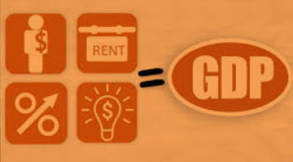
Factor Incomes method
All the income that the households earn through providing the factors of production is equal to the total output of the economy.
Factor payments/incomes
Land – rent
Labor – wage
Capital – interest
Entrepreneurship – profit
Think about it this way: the factors of production are the things that generate money and they are owned by the people. So the income that goes to the people must be the GDP.
3 Ways of Calculating GDP

Slide 13
Factor Incomes
Can be seen on the circular flow model.

Slide 14
Not Counted in Gross Domestic Product
Intermediate goods (Finished goods only)
eg. We don’t count the flour that the baker buys to make their bread (double counting) video link
Things not produced in that year
2nd hand goods not counted
Financial assets
these represent change of ownership or borrowing but no production
Non-market activities (ppt section)
Shadow economy
Eg. A plumber fixes a friend’s sink
A farmer sells fruit at the side of a road
Illegal activities
Environmental Things
polar bears are born
a rainforest is cut down (arguably this should decrease GDP but is not counted)
Wealth Inequality
A country could have a high GDP and even high GDP per capita but that could be due to many very rich, even if there are many poor in society. Wealth inequality is considered a negative thing.

Slide 15
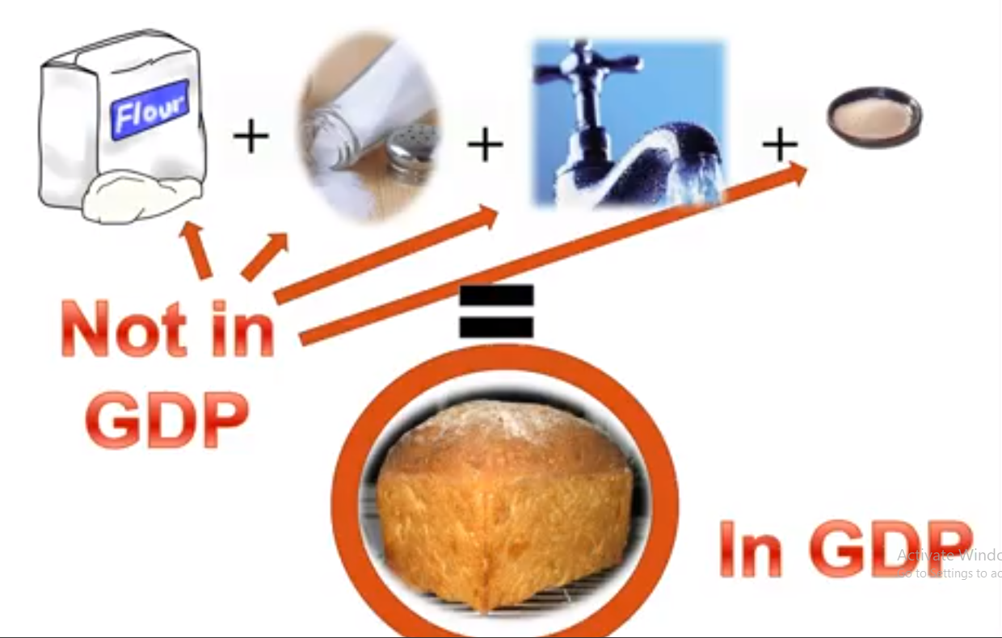
Problem: Double Counting GDP
We only count the final goods and services.
Otherwise we will count them twice.
The goods and services that are used to make goods and services are not counted.
Eg. A loaf of bread. We don’t count the flour, salt, water etc.
Summary
Do not count intermediate production, only the final goods.

Slide 16

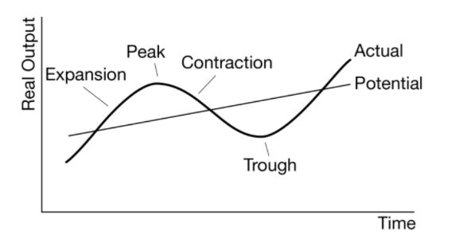
The Business Cycle
Note: Because technology and productivity is generally increasing (eg. better machines, faster computers, faster planes and trains), GDP usually increases over time, so the trend growth or potential output is upward sloping.
Trend line

Slide 17
3 Crucial Economic Indicators
The three biggest economic indicators used in Macroeconomis are:
Gross Domestic Product (how big is the economy)
Unemployment (how many people have jobs)
Inflation (how stable are the prices of goods and services)
Economic Indicators
Gross Domestic Product (GDP)
Unemployment
Inflation
3 Economic Indicators

Slide 18
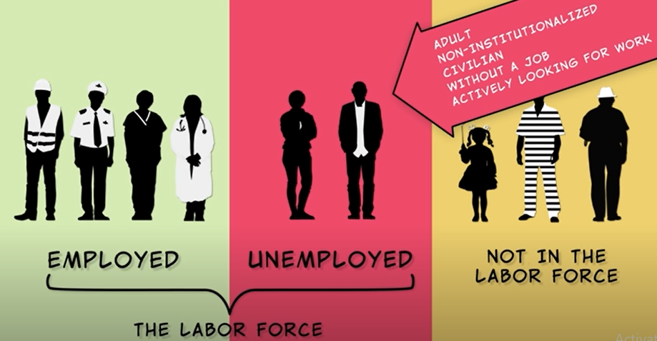
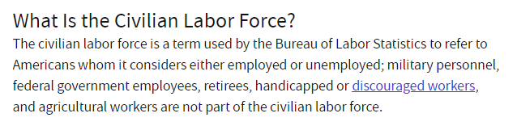
The Labor Force
Summary
Labor Force = people over 16 looking for work
= unemployed + employed
The labor force includes all people who ARE or ARE TRYING to participate in work as a profession.
Note: This means that if you don’t have a job but are at least trying to get one, you are in the labor force even if you’re not working.
Labor Force
Old enough (usually 16+ years)
Capable of working (eg. healthy and mentally capable)
Actively looking for work
Not in prison or other institutions
Note: Different definitions of the labor force can exist that do or don’t include different types of workers etc.

Slide 19
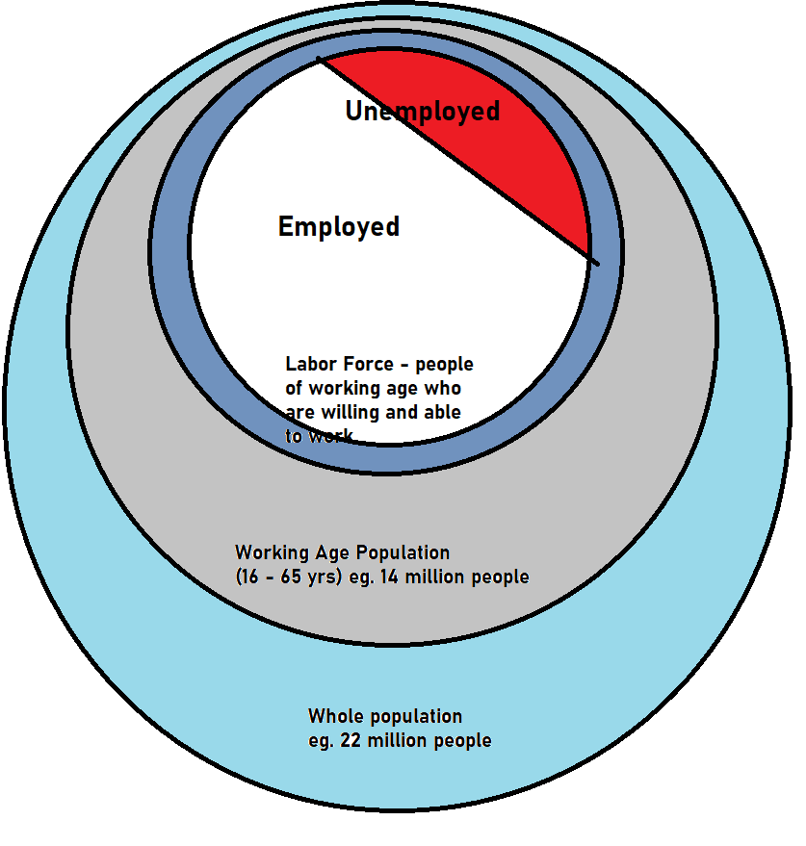
Labor Force Participation Rate
Labor force participation = people who are 16+ and seeking work / people who are 16+ and could work
= employed + unemployed / working age population

Slide 20
Unemployment Rate
Unemployment rate = unemployed / labor force
= unemployed / (unemployed + employed)

Slide 21


Underemployed and Discouraged workers
Summary
Discouraged workers – given up searching
Underemployed – not enough hours or not using full skills
Neither of these count as unemployed but they are jobless/underutilized
Critics claim the unemployment rate does not tell the full story.
Why? There are two often sited arguments against the unemployment rate are:
Underemployed workers
They are technically employed but can’t find enough work hours. Eg. Only working part time when they want a full time job.
They may be unable to find a satisfying job that makes full use of their skills.
Eg. A college graduate can only find part time work as a waiter when they want to work full time work in a field relevant to their qualification.
Discouraged workers
Members of the work force may become tired of not finding employment and may give up the search.
They are technically no longer unemployed because they have to be actively seeking work in the last 4 weeks*
Both of these factors contribute to the rate of joblessness or of worker dissatisfaction and are therefore a problem! However, neither of these things are measured in the unemployment rate.

Slide 22

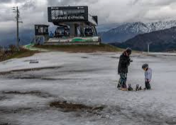
Types of Unemployment
Frictional – people moving between jobs. This unavoidable and not a particularly negative thing because it is not considered long term.
Structural – there is a long term imbalance between people’s skills and the jobs available. Either firms can’t find the right people or people can’t find the right jobs. Eg. A factory closes down in a town and many people lose their jobs. Link
Note: Some people argue that the minimum wage (a form of price control), contributes to structural unemployment.
Technological – could be classed as a type of structural unemployment. Involves the loss of jobs due to technology. Eg. Bank tellers replaced by ATMs and Electronic Funds Transfer.
Seasonal – Eg. A ski instructor only works in winter. An ice cream vendor only sells in summer.
Cyclical – when the economy slows down there are less job opportunities. Eg. The present COVID induced recession. Link
The opposite is also true for when the economy enters a prosperity phase; there will be more jobs.
Link

Slide 23
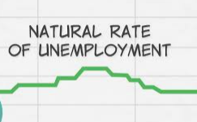
The Natural Rate of Unemployment
Link
In short, this is the default level of unemployment! This is the level when the economy is at a good and healthy level.
A certain amount of unemployment is inevitable even when the economy is healthy. This level is the natural rate of employment.
Natural Rate of Unemployment (NRU) = Frictional unemployment + Structural unemployment
NOT EQUAL TO ZERO
It is calculated this way because even when there are no ‘problems’ with the economy, these two types of unemployment are unavoidable.

Slide 24
Unemployment Equations
Unemployment Rate = unemployed / labor force
= unemployed / (employed + unemployed)
Labor Force = employed + unemployed
Labor Force Participation Rate (LFPR) = labor force / working age population
= (employed + unemployed) / Working age population
Unemployment Rate with more discouraged workers
= (Unemployed – X) / (Labor force – X)
Natural Rate of Unemployment:
NRU = Frictional + Structural
= (Frictionally unemployed + structurally unemployed) / labor force
Actual Rate of Unempl = NRU + cyclical
When there is the NRU, cyclical unemployment = 0

Slide 25



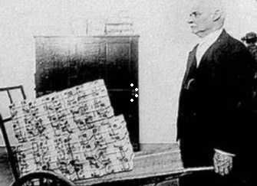
Price Level vs Inflation
Summary
Price level – doesn’t matter because people will have more money.
Inflation – acceleration of the price level, it does matter.
Inflation is the change in price level.
The price level itself doesn’t make a difference because if the price level is high, the amount of money people have will also be high.
$100
$10
 | Price Level | Value of Money
Inflation | Increases | Decreases
Deflation | Decreases | Increases
$10,000
$1000
In both cases you can still buy 10 pieces of candy.

Slide 26
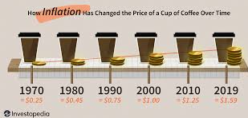
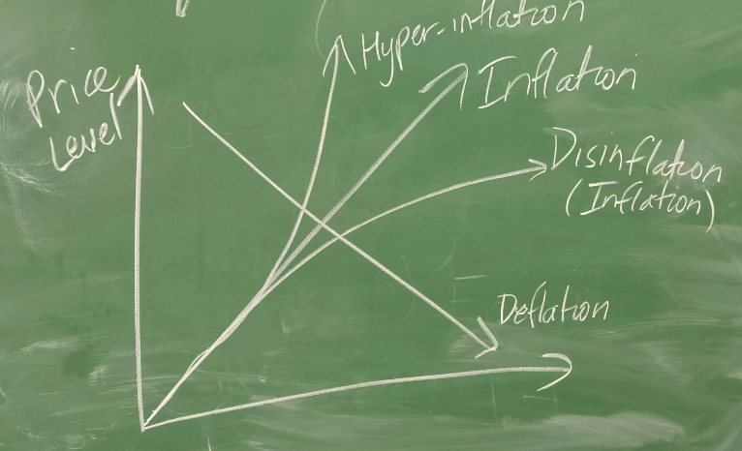
Inflation Terms
Inflation = rise in price level
Hyper-inflation – a huge rise in price level
Usually only occurs in poor countries with flawed economic management
Money can also become worthless.
Disinflation = rise in price level but at a slower rate eg. 4% inflation to 2% inflation
The price level is still increasing!
Deflation = fall in price level

Slide 27
Nominal vs Real
We will often see these terms ‘nominal’ and ‘real’.
Expressed simply:
Nominal = the numerical value
Real = the true value
This can affect many things including our wages.
Summary
Nominal wage – the numerical value
Real wage – how much you can actually buy
Example
You receive an increase in your wage by 50%. You are extremely happy.
However, the inflation in the economy has been severe. The prices of all goods and services have doubled (increased by 100%)
Should you still be happy about your wage increase?
Actually no. Why? Because the price of goods and services has increased by more than your wage. You can now afford to buy less than before.
Expressed formally – your nominal wage has increased but your real wage has decreased.
Nominal Wage
Eg. 10K – 15K
Real Wage
You can buy less goods.

Slide 28

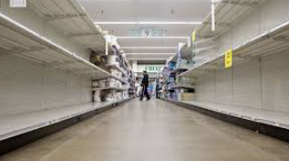
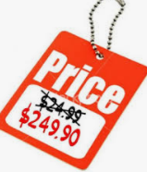

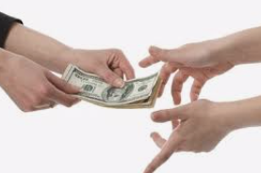


Consequences of Inflation Summary
Business and Transaction costs ___
Menu Costs
Shoe Leather Costs
Redistribution of wealth ___
Value of money savings falls
Fixed Income individuals lose (eg. pensioners)
Borrowers gain at the expense of lenders
Inefficient allocation of resources ___
Inflation distorts prices which makes business decision and everyday decisions more difficult
Consequences of Inflation Home

Slide 29
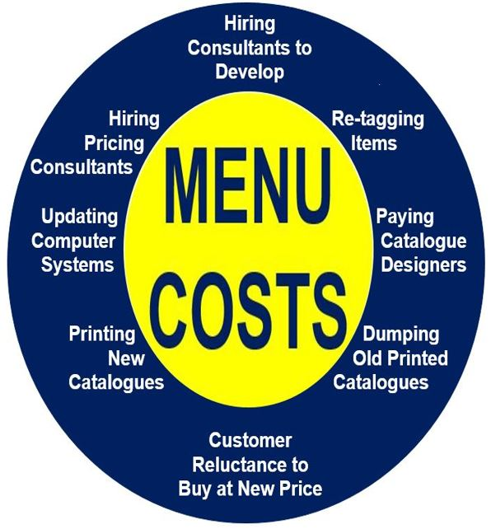
Consequences of Inflation - Business and Transaction costs
Menu Costs – businesses must calculate new prices and then update the prices of their products on menus, websites, signs, billboards, brochures and other places which requires time and money
Shoe Leather Costs – individuals will often spend large amounts of time and effort converting cash into other things which are more stable. This is called shoe leather costs because it will in some cases literally ‘wear out their shoes’ as they make efforts to move and convert money. Note: China is a largely cashless society and so shoe leathers would be less because people do not need to physically withdraw money from the bank.
Consequences of Inflation Home

Slide 30
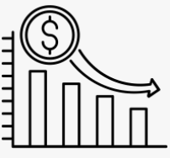

Consequences of Inflation - Redistribution of wealth
Fixed and Nominal Incomes worth less - Those on fixed incomes (eg. a pensioner on $100 a week) will see the value of their incomes fall if the price level rises.
Lower Value of Savings – holders of money will see the value of their savings decrease. This decreases the incentive to save which will in turn affect investment.
Borrowers gain and lenders lose – if the inflation is more than expected then borrowers will pay less money in real terms to pay back loans, and lenders will receive less in real terms. Eg. A borrower pays $50 per week, but the $50 is now worth less
Note: We will revisit the Fisher Effect in more depth in following units
Consequences of Inflation Home

Slide 31





Example – Nominal vs Real Interest
Eg. The bank has expected/anticipated inflation to be 3% and wants borrowers to pay 5% real interest.
Nominal interest = real interest + inflation
So the bank will set a 5+3=8% nominal interest rate.
Before:
Nominal interest = 8%
Real Interest = 8-3 = 5%
If inflation increases to 5%
the bank will now only receive a 3% (8-5%) real interest from the borrower.
Therefore the borrower gains and the lender (bank) loses.
After:
Nominal interest = 8%
Real Interest = 8- 5 = 3%
Consequences of Inflation Home

Slide 32

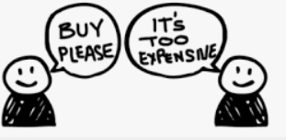
Consequences of Inflation - Inefficient allocation of resources
Money confusion and price illusion
Inflation confuses prices – businesses and individuals use prices to make decisions about what to buy and sell. Money is often used as a unit of account to measure real value but if prices are increasing it can be difficult to know if it is caused by changes in supply or demand or merely inflation. This leads to less efficient decision making and use of resources because it is hard to measure the value of something.
Reduced incentive to save & excessive consumption– individuals who see the price of products increasing may consume now for fear of further price increases, leading to a distortion of market preferences.
Price illusion – people can’t tell the difference between inflation and real increases in price. They may also buy less than usual. Eg. “Clothes are so expensive these days. When I was young I would only pay $10 for a pair of jeans!”
Consequences of Inflation Home

Slide 33




Nominal vs Real GDP
Nominal GDP is measured in terms of money at current prices.
As we have already looked at, money is subject to changes in its value due to inflation.
Therefore, in order to solve this problem, real GDP is used instead.
Real GDP is adjusted for inflation, and it measures:
how much is really generated from economic growth (ie. the additional output produced)

Slide 34

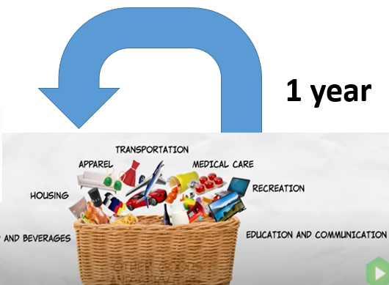
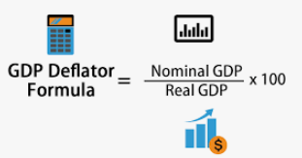
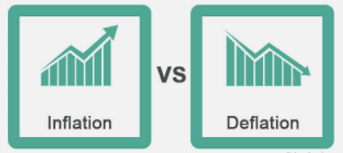
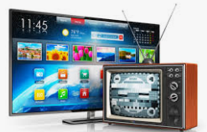
Price Indexes
Problems with the CPI
The CPI fails to take into consideration the changes in:
The quality of goods and services over time.
Eg. TVs, Cars, Computers are faster, more reliable and have more features compared to the past
The typical household market basket can change over time
New products – eg. Smartphones or even mobile phones didn’t exist 50 years ago and so it is hard to compare identical baskets
Tastes – eg. people start buying more leisure goods compared to past years which also changes the basket
Substituting goods for other goods. Eg. if the price of bread increases, people may buy more potatoes and so the price increase won’t affect consumers as much
Overstate inflation!
Consumer Price Index (CPI)
Takes a large basket of goods
Based on goods and services that consumers purchase
Measures imports (because the consumer basket will include imports (eg. iPhones, French wine, German Cars, American Movies)
The base year for the CPI is always 100
CPI = CPI Basket / CPI Basket_{base year} x 100
GDP Deflator
Compares nominal and real GDP
Based on goods and services produced in the economy
Doesn’t measure imports (only things produced as part of GDP)
The base year GDP deflator is also always 100.
Overstates or understates inflation!
Overstates or understates inflation!
Overstates inflation!
Price Index > 100
Inflation
Price level has increased
Price Index < 100
Deflation
Price level has decreased

Slide 35
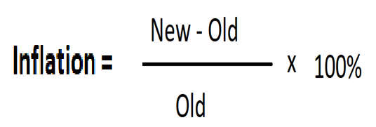
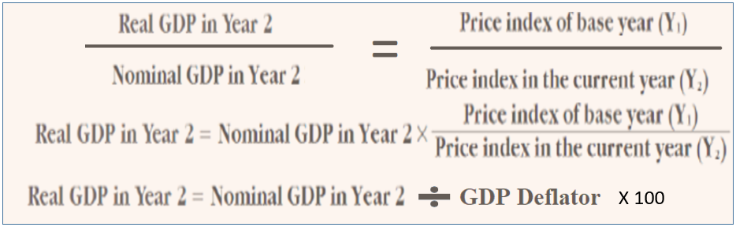
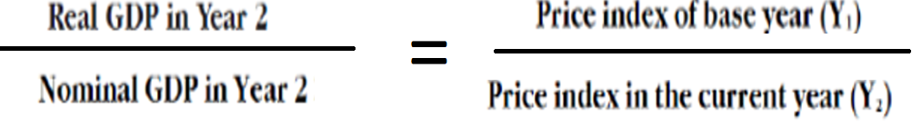
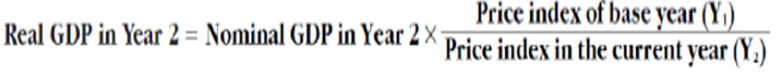

Equations Regarding Inflation
CPI = Market Basket / Market Basket_{base year} x 100
GDP Deflator = NGDP/RGDP x 100
X 100
Calculating GDP with Price and Quantity
NGDP = Prices_{current} x Quantity_{current}
RGDP = Prices_{base} x Quantity_{current}
Fisher Equation (Explains real interest rate and inflation, named after economist Robert Fisher):
Nominal Interest = Real Interest + Inflation
Eg. The bank charges 5% interest for its mortgages and the inflation rate is 2%. The real interest rate is 5-2=3%.
Real Wage:
Real Wages = Nominal Wages x PI_{base} / PI_{current}
Note: As an approximation one can use: %△ Real Wages = %△ Nominal Wages – Inflation, but this is only an approximation
Eg. Your boss gives you a raise of 5% from last year and inflation is 3%. Your real wages have increased by 5-3=2% approximately.
i = nominal interest
r = real interest
Π = inflation
Actual Inflation = Expected Inflation + Unexpected Inflation
(Unexpected Inflation – benefits borrowers, Unexpected deflation – benefits lenders)

Slide 36
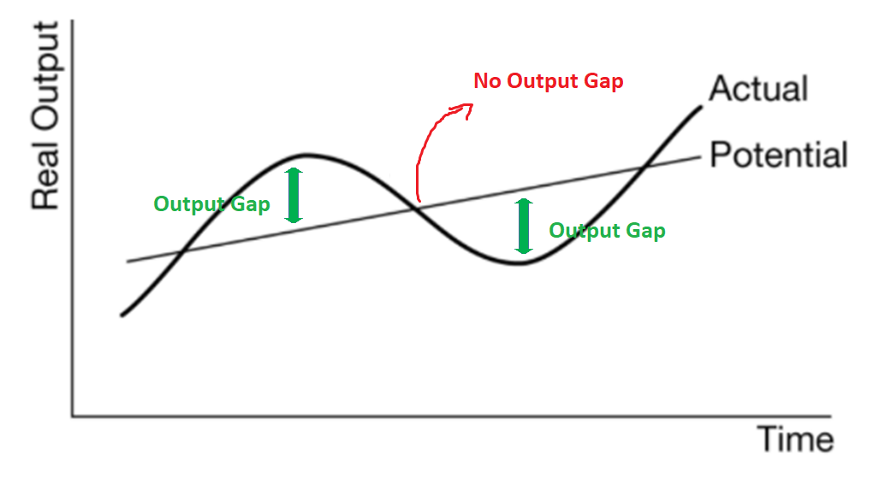
Output Gaps
Potential output represents the output when the economy is at it’s ‘happy level’ and is a theoretical level.
Actual output is the level of production we see in the real world which often is different from the potential output.
We call the difference between Actual Output and Potential Output an output gap.
The difference between Actual and Potential output is called an output gap!
The economy is therefore in three states:
Potential Output (happy level where Actual Output = Potential output)
Positive Output Gap (producing at a higher but not sustainable level)
Negative Output Gap (the economy is underperforming)
Output gap = Actual Output – Potential Output

Slide 37



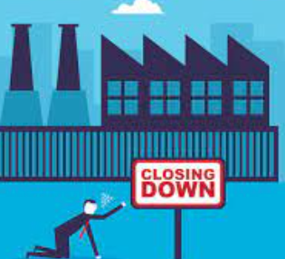
GDP
Expansion – GDP increases
Contraction – GDP Decreases
Actual Output > Potential Output
Positive Output Gap:
Actual Output > Potential Output
Actual Output = Potential Output
Actual Output = Potential Output
Actual Output < Potential Output
Negative Output Gap:
Actual Output < Potential Output

Slide 38

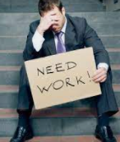
Unemployment
The Natural Rate of Unemployment, NRU, occurs when Actual Output = Potential Output
Expansion – unemployment decreases
Contraction – unemployment increases
UR_{actual} < NRU
Positive Output Gap:
Actual UR < NRU
(more jobs = lower unemployment)
NRU
NRU
UR_{actual} > NRU
Negative Output Gap:
Actual UR > NRU
(few jobs = higher unemployment)

Slide 39

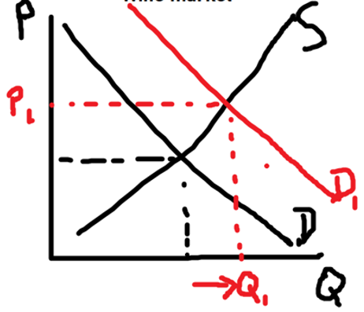

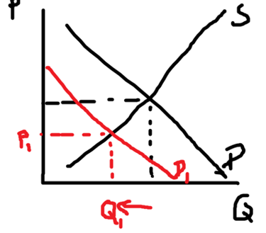
Inflation / Price Level
Summary
Positive Output Gap:
Higher demand -> Higher price level
Negative Output Gap:
Lower demand -> Lower price level
Expansion – people are consuming more goods which tends to increase the price level ie. inflation
Contraction – people are buying less goods which tends decrease the price level (deflation or lower inflation)
Higher price level
Positive Output Gap:
Higher Price Level
normal
Normal price level
Lower price level
Negative Output Gap:
Lower Price Level
Note: We will go into more depth about the causes of inflation in the following units.

Slide 40

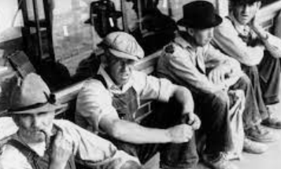
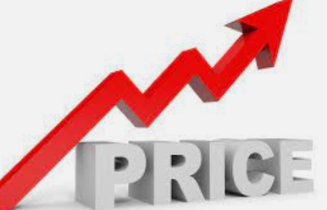
Goals of Government
Summary
The government looks at the three main indicators but has different objectives for each.
Governments try to manage the health of the economy and the three big indicators we have covered in Unit 2 are central to their decision making.
Generally speaking all governments want:
GDP
Government wants this to be:
high
Unemployment
Government wants this to be:
Low
Inflation
Government wants this to be:
Low and stable

